Slide 1
Diyala university
College of engineering
Department of computer engineering
First stage
Computer since
3-Computer formatting and os instillation
LAB
Presented B:Abdullah Thaier Abdalsatir Al-obaidy

Slide 2
Contents
Introduction about operating system.
2. Minimum requirement for Windows 7 operating system.
3. Procedure to install Window 7 operating system.
4. Basic Applications needed to be installed.

Slide 3
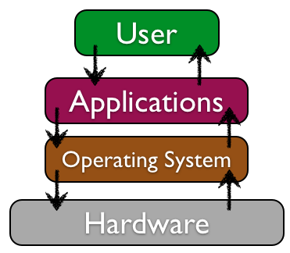
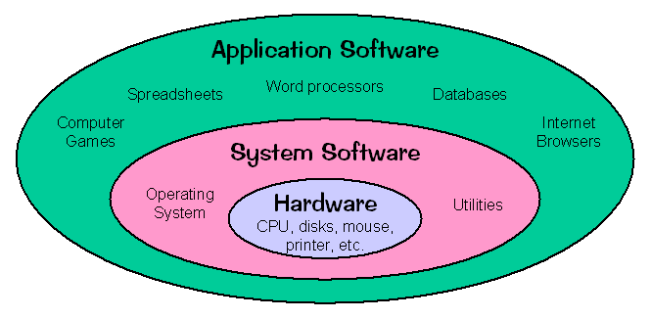
Introduction Operating System

Slide 4
Operating System
– The Operating System provides for the user to utilize the functions of a computer by managing the hardware and software in it. The image Above depicts how the system software and application software interact with the hardware.
The software which facilitate the interaction between human user and hardware is the Operating System. The Operating System provides instructions for installation and management of various application software. Not only that the Operating System manages all the input, output and computer memory too, which means that Operating System is the sole software which manages the whole.

Slide 5
What is the Booting
1.When the user powers up the computer the CPU (Central Processing Unit) activates the BIOS (Basic Input Output System).
2. The first program activated is POST (Power On Self-Test). Using the CMOS (Complementary Metal Oxide Semiconductor) memory this checks all the hardware and confirms that all are functioning properly.
3. After that it reads the MBR (Master Boot Record) in boot drive in accordance with the firmware ‘bootstrap loader’ which is Provided by the computer manufacturer.
4. Then the computer loads in the Operating System in boot drive to the RAM (Random Access Memory). This whole process is called booting which means that an Operating System is loaded into the RAM (main memory)

Slide 6
Minimum System Requirements for Windows 7
Part | Minimum Requirement
Processor (CPU) | 1 GHz or faster CPU
Memory (RAM) | 1 GB RAM (32-bit) or 2 GB RAM (64-bit)
Hard drive free space | 16 GB available disk space (32-bit) or 20 GB (64-bit)
Disc drive | DVD drive
Graphics memory | 128 MB or more

Slide 7
How to Install Windows 7 operating system step by step procedure.

Slide 8
Operating system boot by
1.Flash Drive (Bootable Pen Drive)
2. Bootable CD/DVD
3.Hard Disk

Slide 9
How to Install Windows 7 operating system step by step procedure.

Slide 10
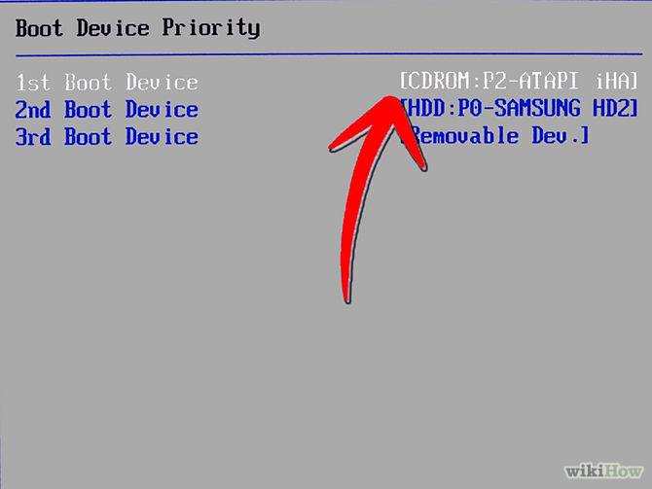
Turn your computer on and then press Del or F2 (depend on your computer’s mainboard) to enter the system BIOS

Slide 11
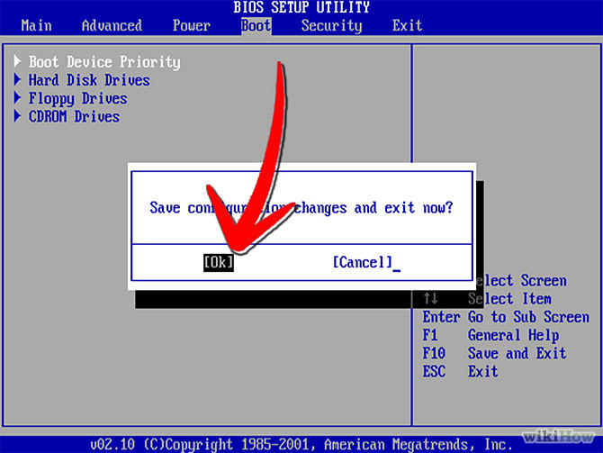
Go to Boot menu and choose Boot From CD/DVD.

Slide 12
Load your Windows 7 DVD and boot it. It will now load the setup files.

Slide 13
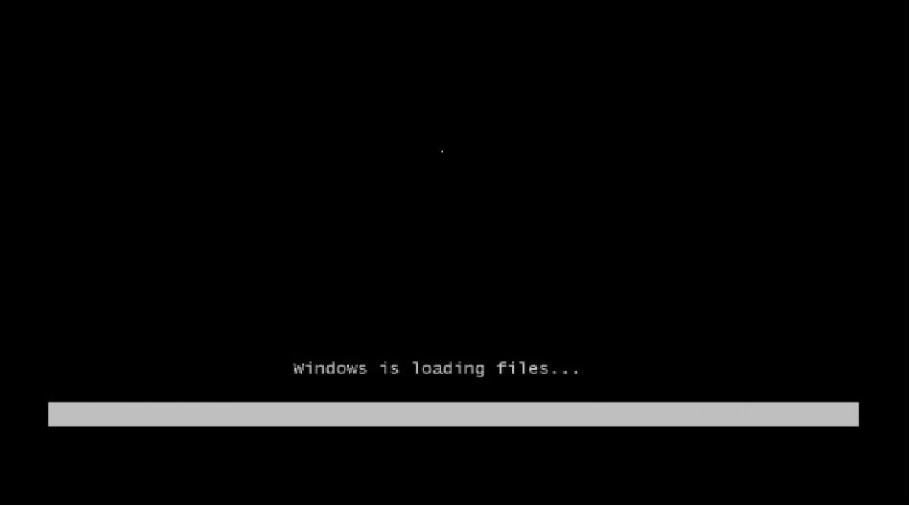
Loading process

Slide 14
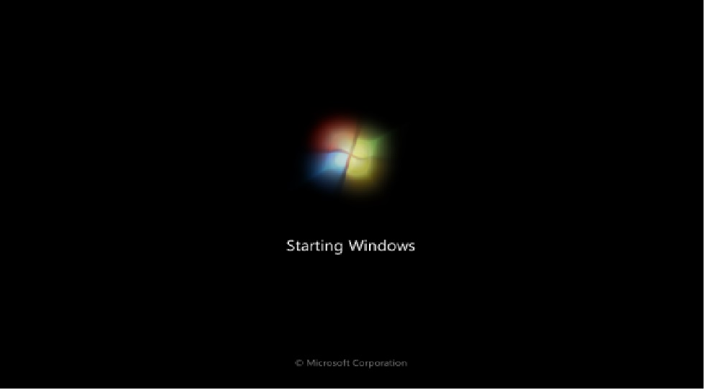
Booting process is in progress

Slide 15
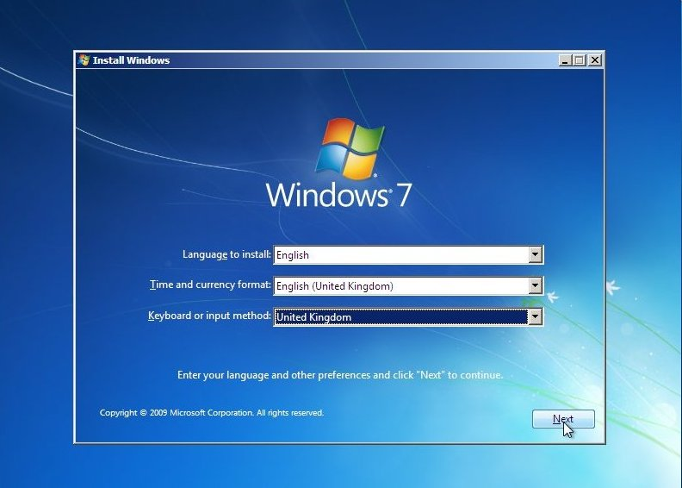
Select your language, time & currency format, keyboard or input method and click Next.

Slide 16
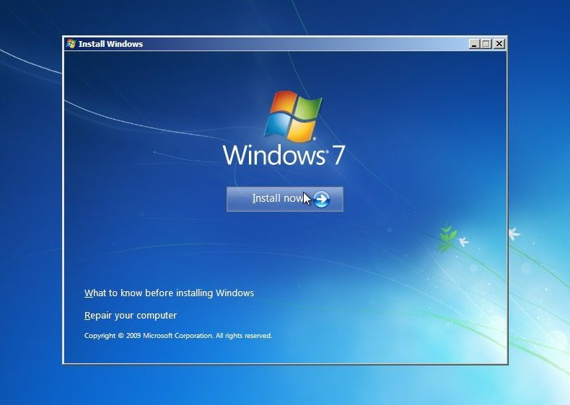
Click Install now.

Slide 17
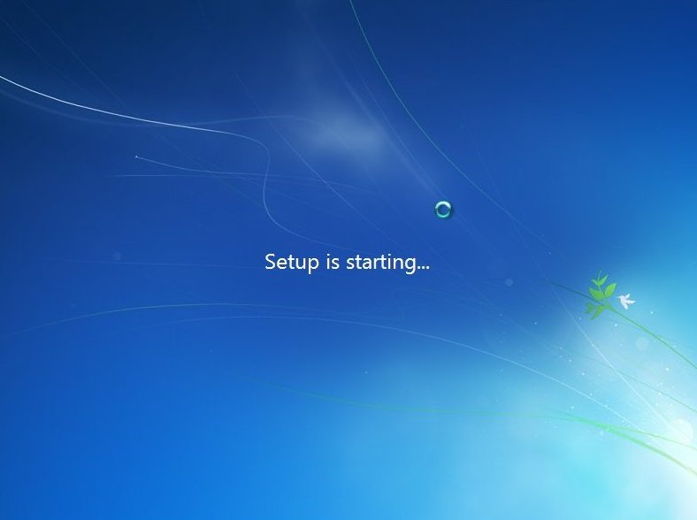

Slide 18
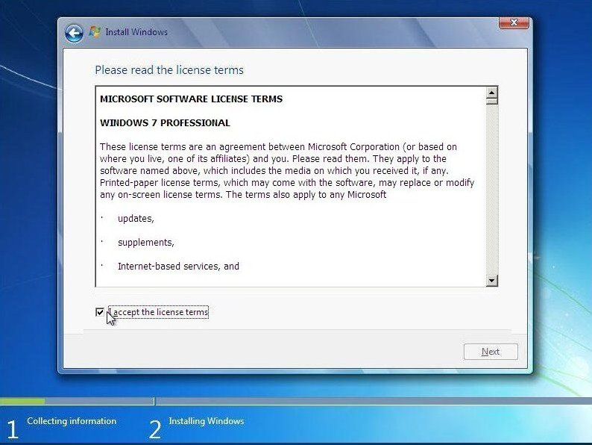
Check I accept the license terms and click Next.

Slide 19
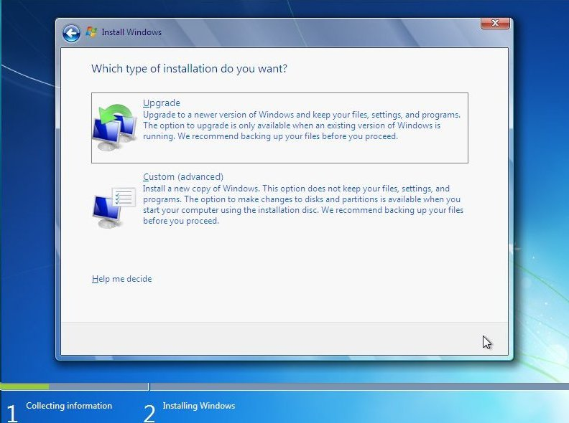
Click Upgrade if you already have a previous Windows version or Custom (advanced) if you don’t have a previous Windows version or want to install a fresh copy of Windows 7.

Slide 20
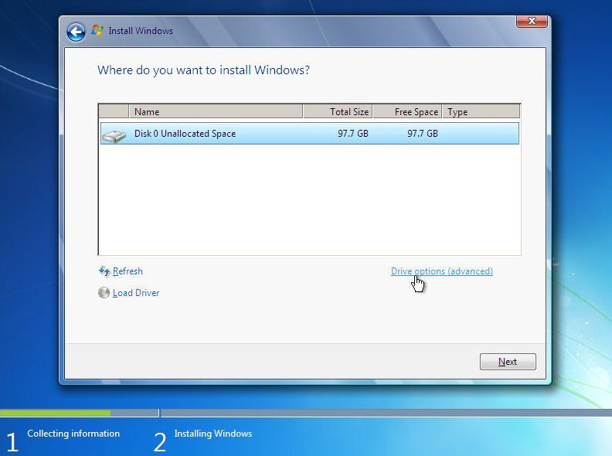
Select the drive where you want to install Windows 7 and click Next. If you want to make any partitions, click Drive options (advanced), make the partitions and then click Next.

Slide 21
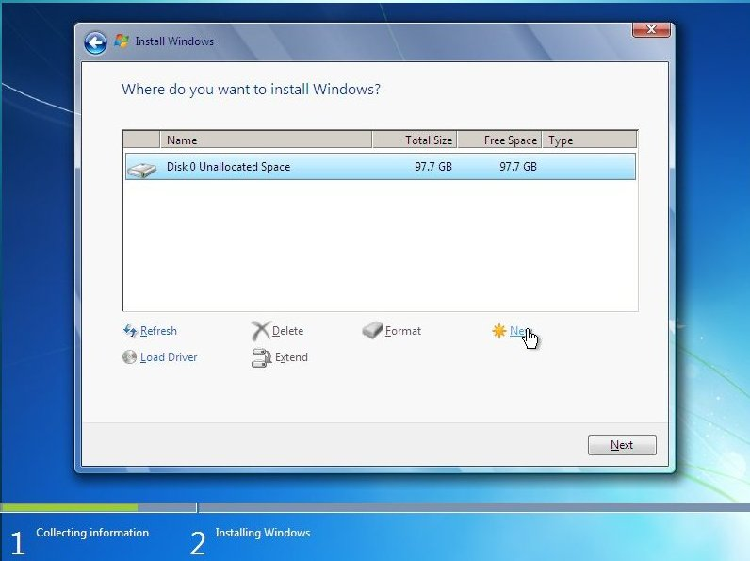

Slide 22
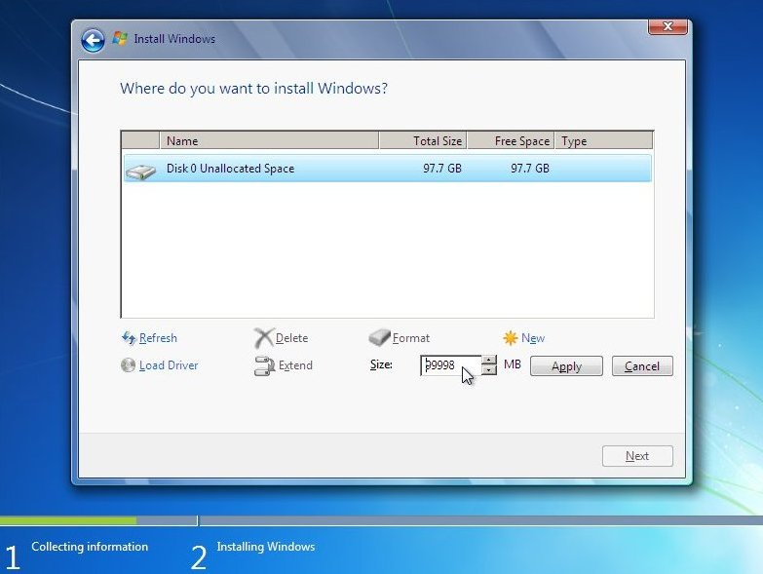

Slide 23
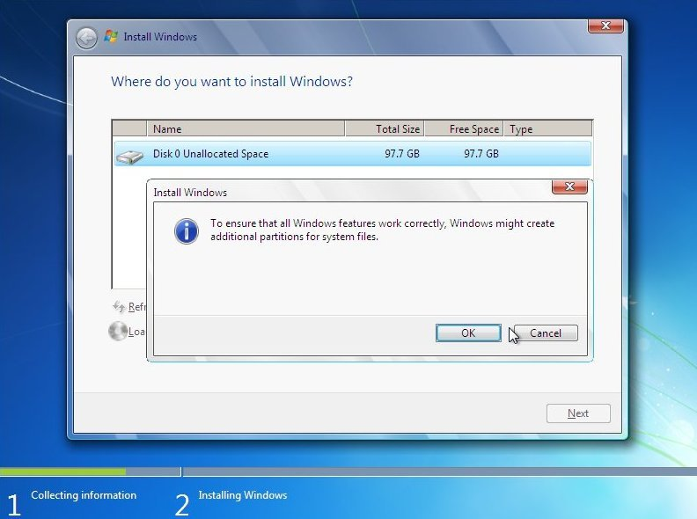
Drive Options Menu: Windows warns that it may need to create a few partitions for the system, Click "OK" to continue.

Slide 24
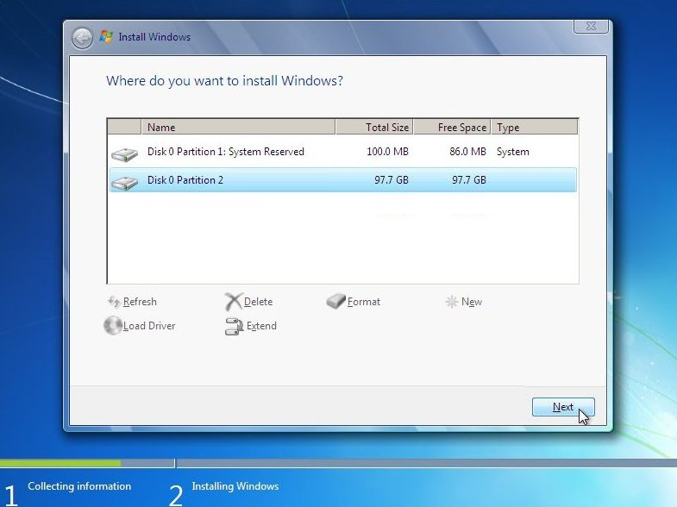

Slide 25
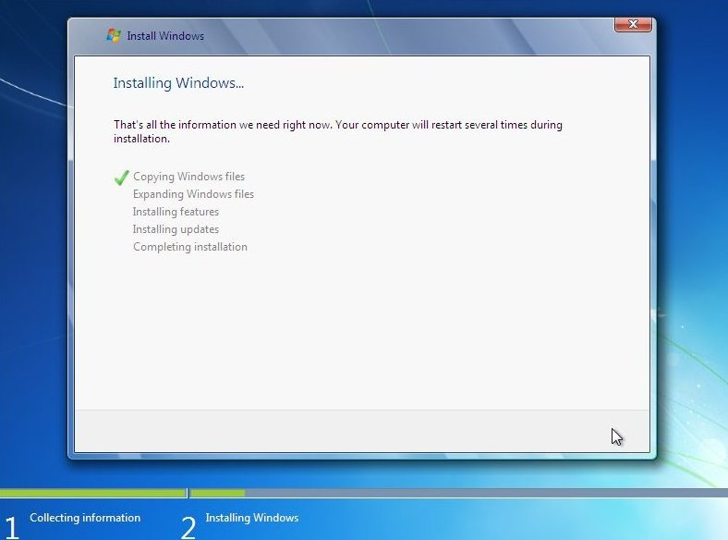
It will now start installing Windows 7. The first step, (i.e. Copying Windows files) was already done when you booted the Windows 7 DVD so it will complete instantly.

Slide 26
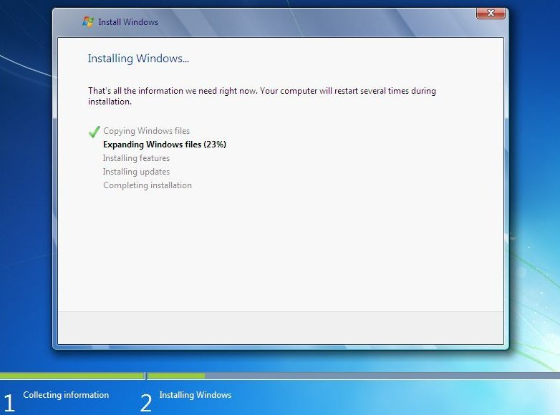
After completing the first step, it will expand (decompress) the files that it had copied.

Slide 27
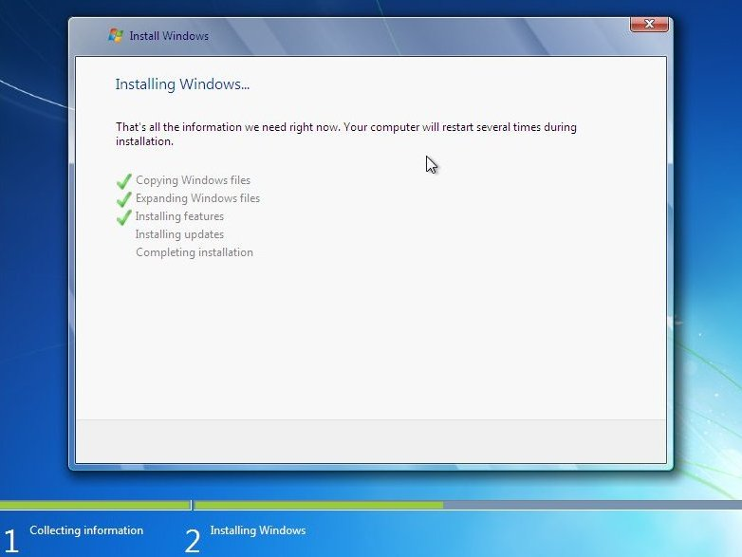

Slide 29
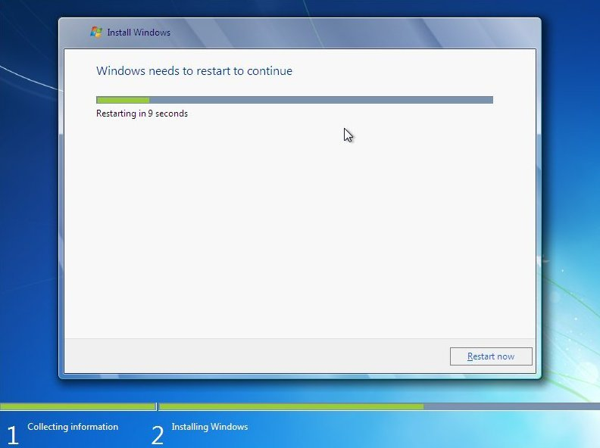
After that it will automatically restart after 15 seconds and continue the setup. You can also click Restart now to restart without any delays.

Slide 30
After installation, Please do not press key this time

Slide 31
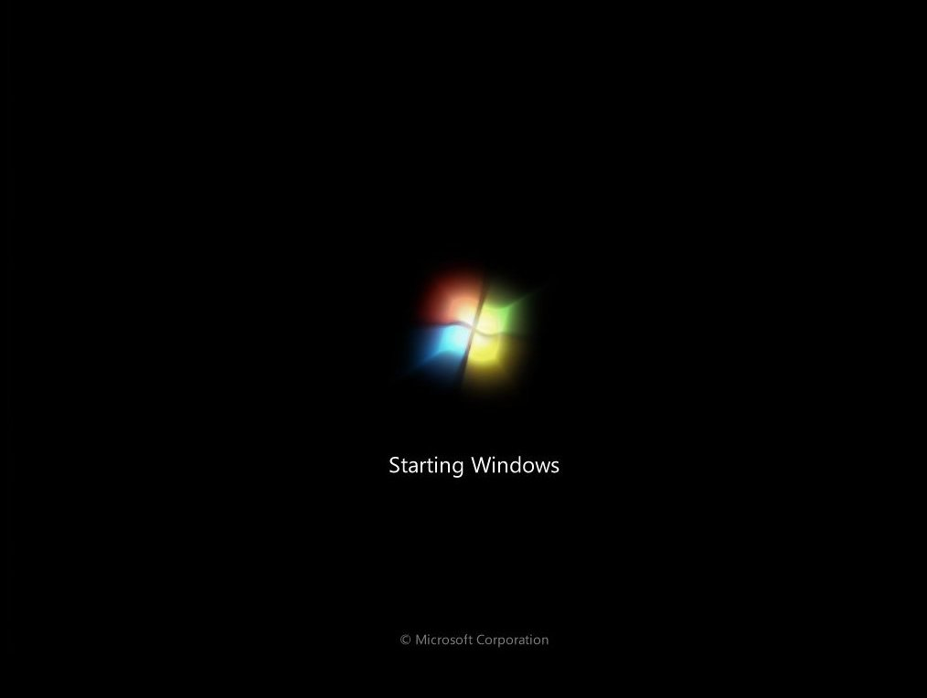

Slide 32
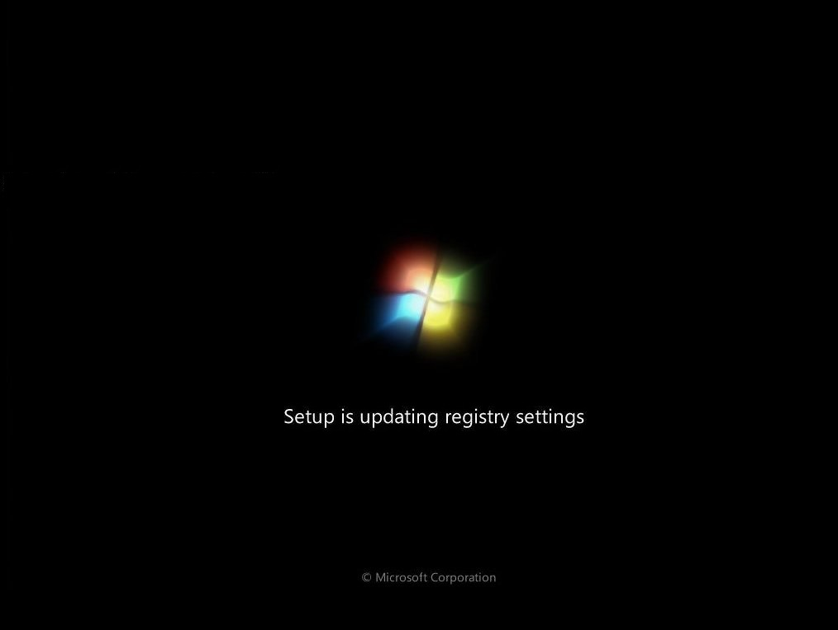

Slide 33
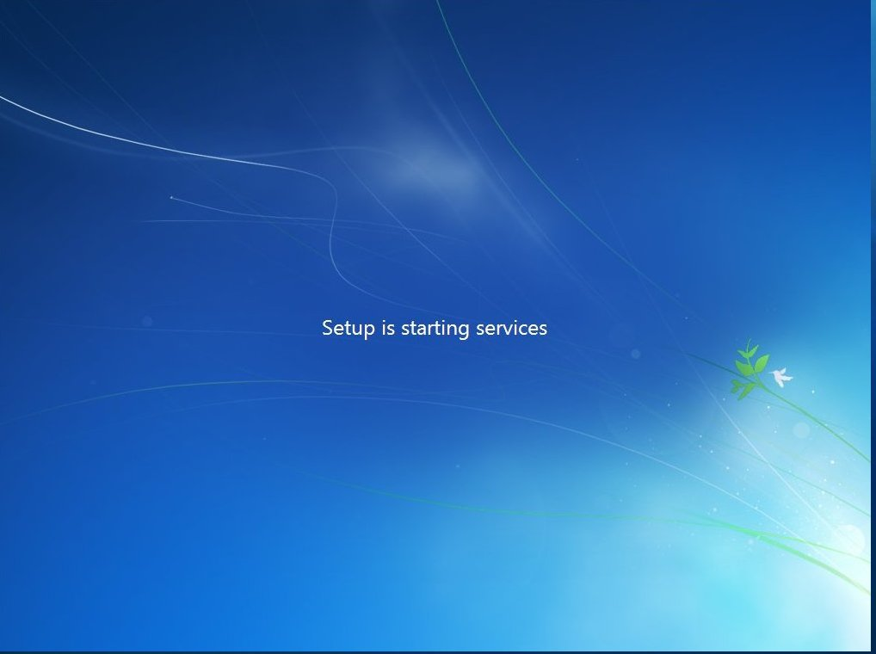

Slide 34
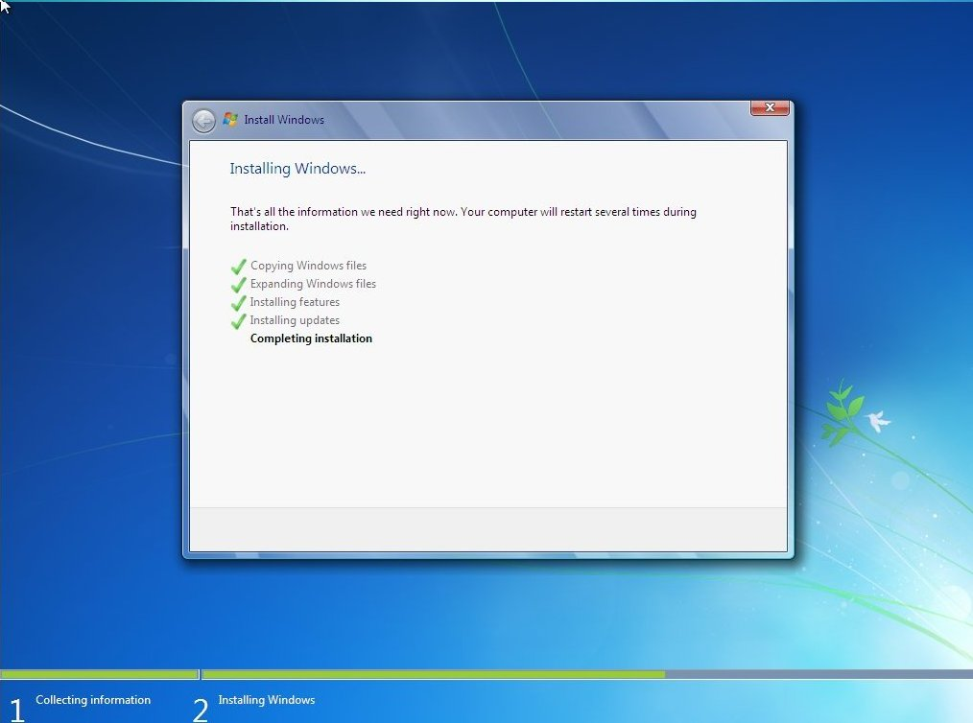
After restarting for the first time, it will continue the setup. This is the last step so it will take the most time than the previous steps.

Slide 35
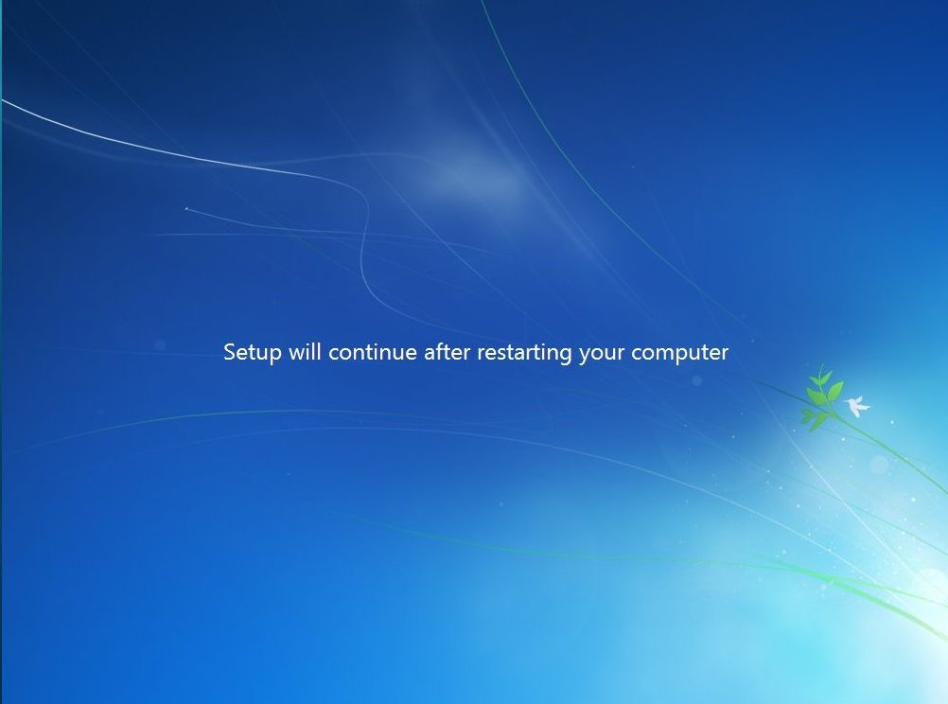

Slide 36
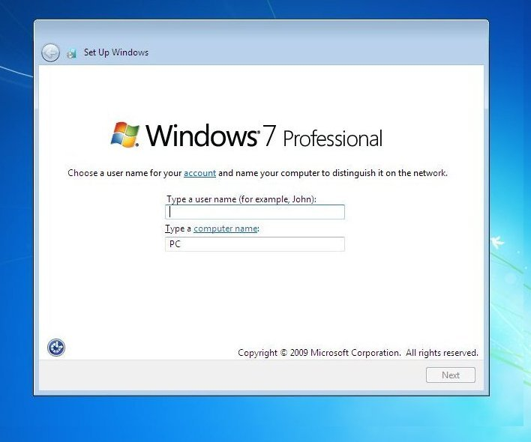
Type your desired user name in the text-box and click Next. It will automatically fill up the computer name.

Slide 37
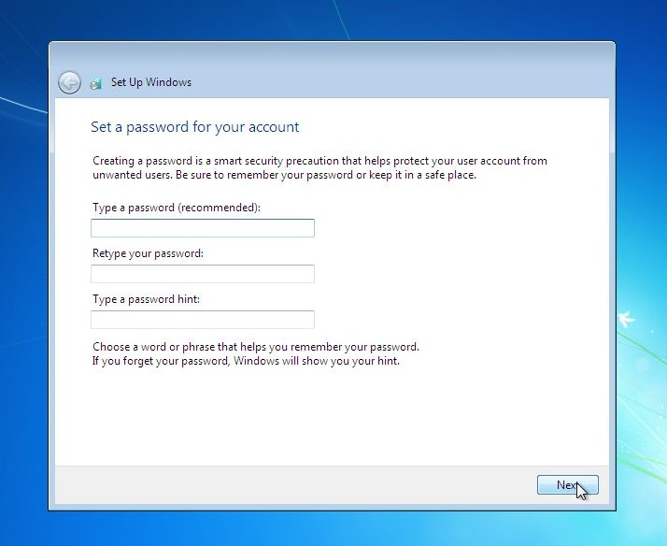
If you want to set a password, type it in the text-boxes and click Next.

Slide 38
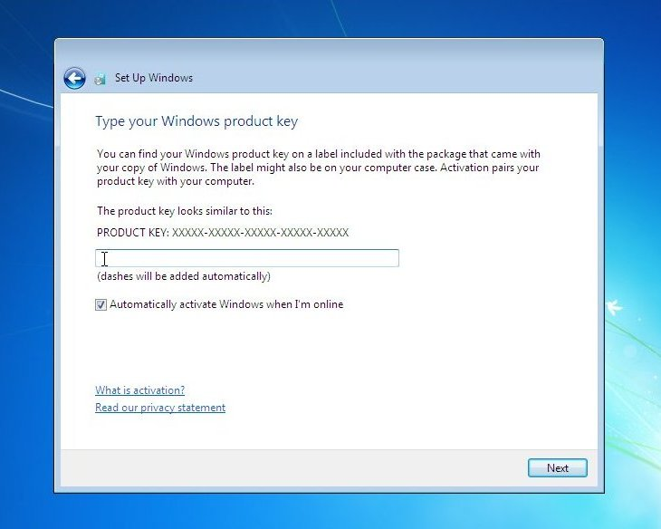
Type your product key in the text-box and click Next. You can also skip this step and simply click Next if you want to type the product key later. Windows will run only for 30 days if you do that.

Slide 39
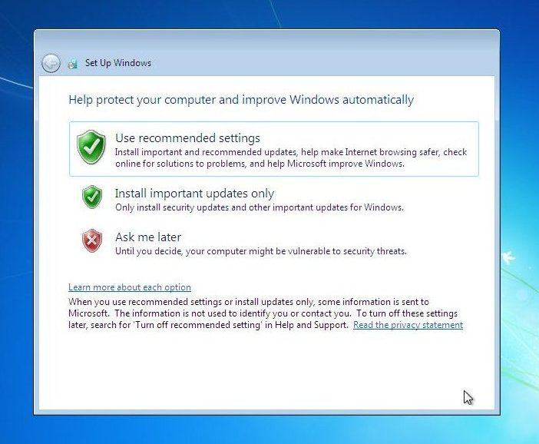
Select your desired option for Windows Updates.

Slide 40
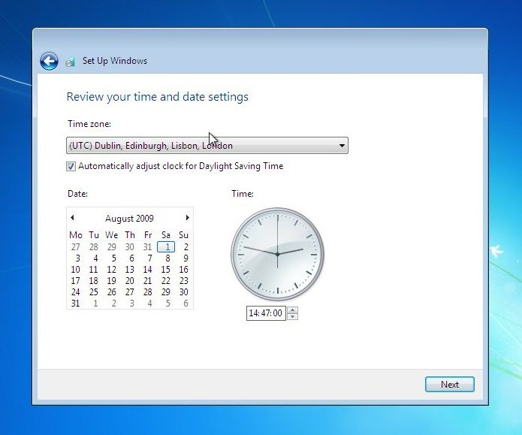
Select your time and click Next.

Slide 41
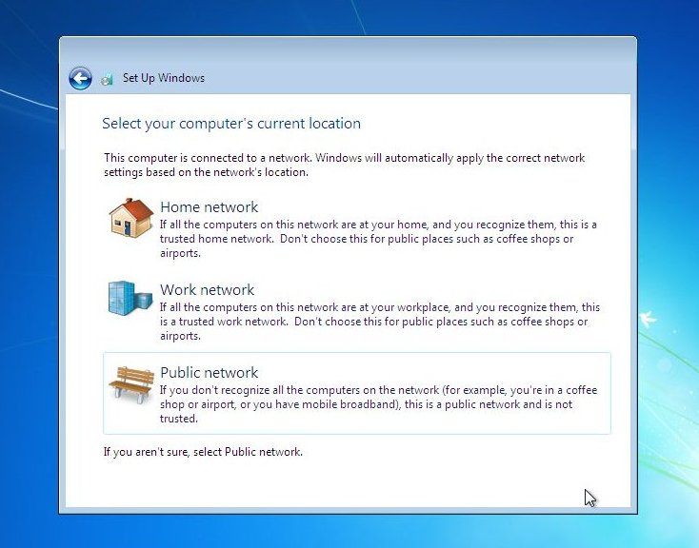
If you are connected to any network, it will ask you to set the network’s location.

Slide 42
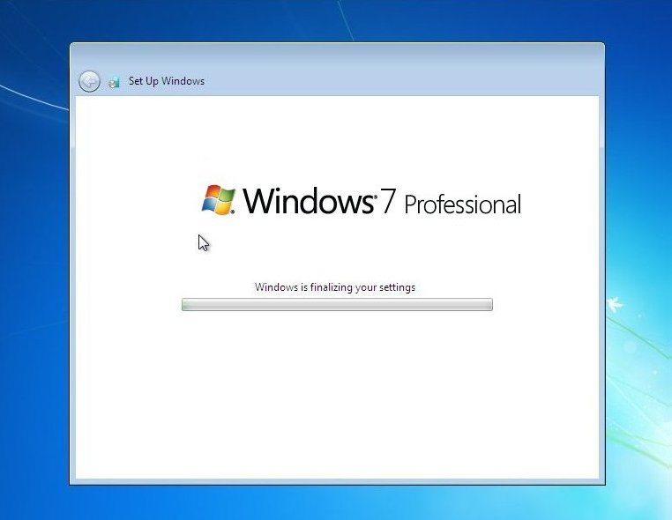
Window is finalizing your settings

Slide 43
Welcome Screen

Slide 44
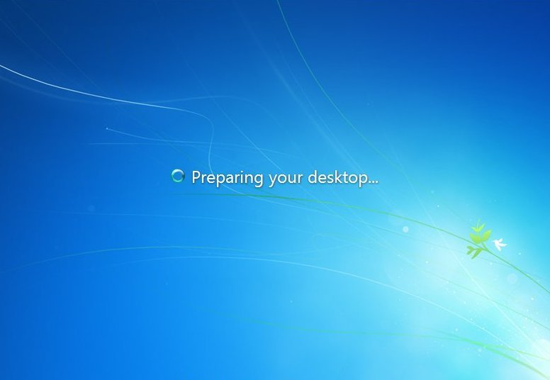
Preparing your desktop

Slide 45
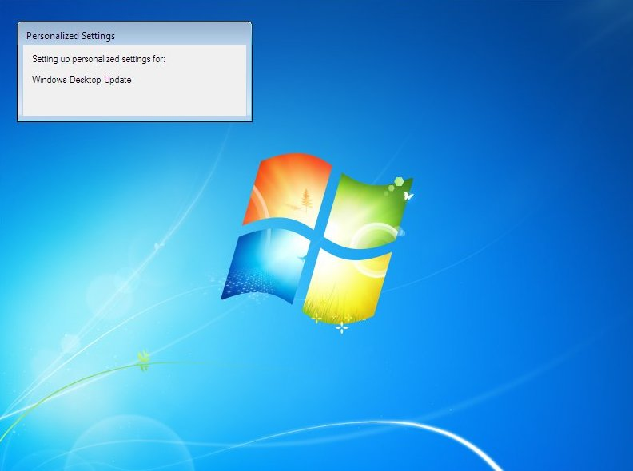

Slide 46
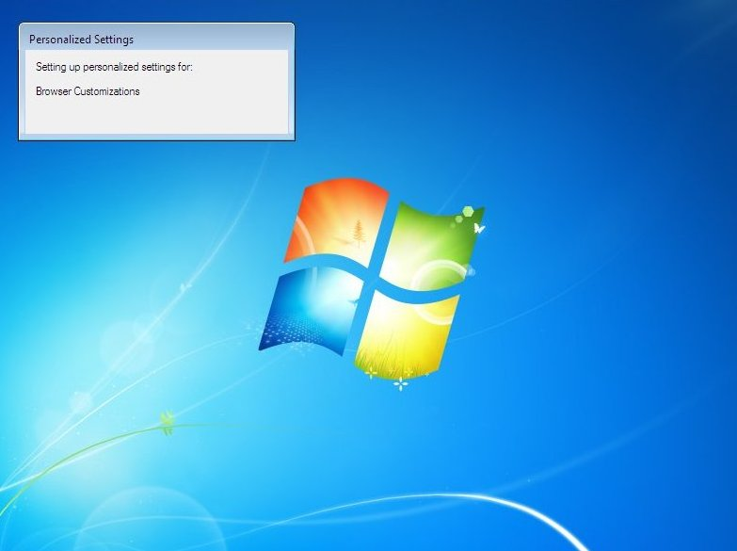

Slide 47
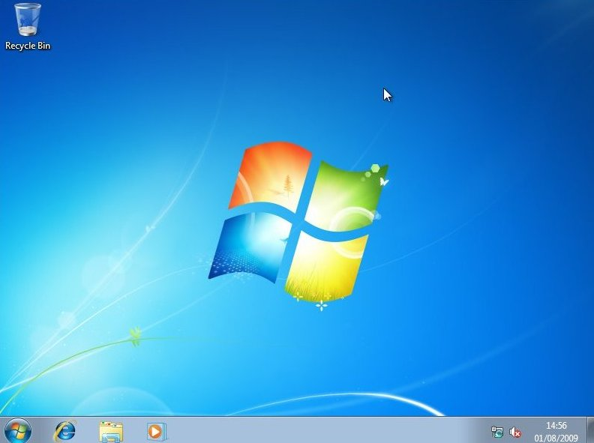
And there you have a fresh copy of Windows 7 installed!

Slide 48
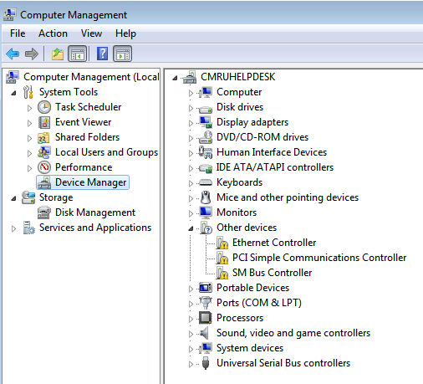
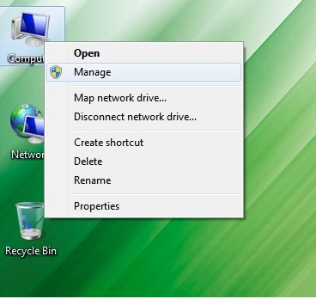
Firstly should Install Drivers on your pc. Check whether properly installed the Drivers by Computer Right click Manage Device Manager
See the Yellow color mark, it means should install drivers.

Slide 49
Basic things or application to be install
1.Compress Software
2.Antivirus – (Department - Virus Guard)
3.Microsoft office (office 2007 – office 2013) or Libre Office(Free Download)
4.Browsers
5.Adobe Reader
6.Unicode (iskoola Potha)
7.Printers installation

Slide 50
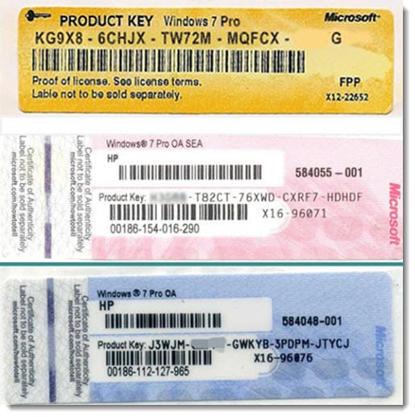
DCS Consideration of Software
1. Genuine Operating System should Install. Because Department Used only Genuine OS
You have to preserve this key on your PC.
2 . if you haven't got a Genuine OS CD(you have pirated CD/DVD) don’t afraid! You installed OS by Pirated , after Use this command.
I . Use Run (window key + R) type Slui 3(slui space 3) – appeared windows activation window & type your genuine OS Product key on the PC.
II. Use Run (window key + R) type Slui -3(slui space -3) – appeared whether windows Genuine or not.

